Slide 1



Public Transportation System
ARRUBIO, MILWAUKEE D.
BAJAO , CHRISTIAN S.
DEGRACIA, RENATO S.
BORRES, EMELIZA A.
PADERAN, JERALDINE F.
NAME OF PRESENTER
Designation

Slide 2

INTRODUCTION
The Public Transportation System (PTS) seeks to reduce terminal inefficiencies by delivering real-time updates and accurate information on public transportation. This software solution intends to improve travel experiences, increase passenger satisfaction, and promote the usage of public transit. The PTS system has the potential to modernize traditional transportation networks, making them more efficient and technologically integrated, allowing for more informed journey options.

Slide 3
Objectives
The Public Transportation System (PTS) provides reliable information regarding public transportation in real time, with the goal of improving terminal inefficiencies. This software program seeks to improve passenger satisfaction, promote public transportation utilization, and improve travel experiences. By converting outdated methods into cutting-edge, effective, and electronically connected services, the project hopes to empower travelers to make well-informed travel choices.

Slide 4
Scope and Delimitation
Scope:
Development of a Public Transport System (PTS) focused on improving user experience and administrative processes.
Features include:
User interface for selecting terminals and destinations.
Display of available vehicles (e.g., buses and vans) with details such as vehicle type, ID, destination, driver name, contact number, and plate number.
Route planning with estimated arrival times and travel fares.
Administrator interface with secure login and role-based access control for managing system settings and information.

Slide 5
Scope and Delimitation
Delimitations:
Excludes vehicle maintenance and real-time tracking.
Usable only in selected terminals.
Does not address traffic management or transport network optimization.

Slide 6
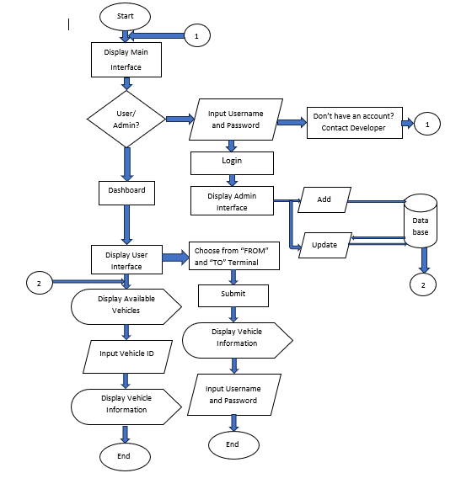
FLOWCHART

Slide 7
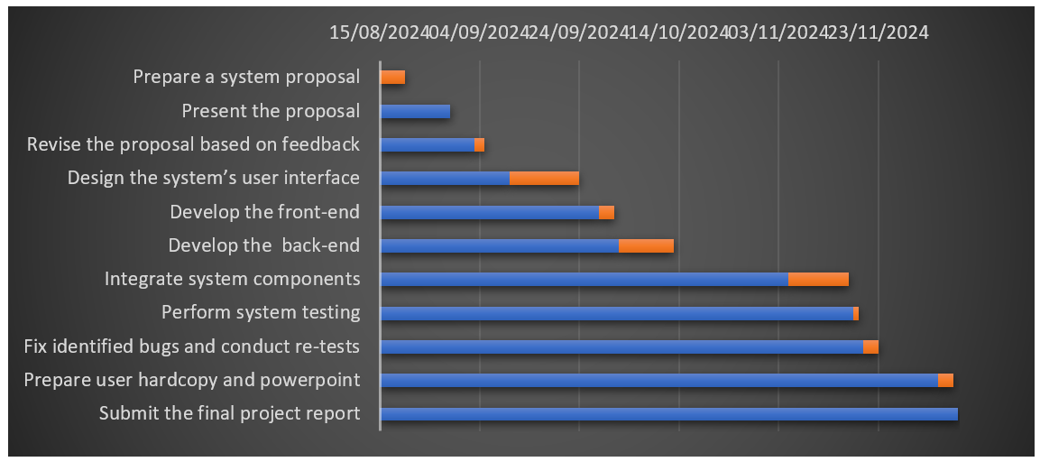
GANTT CHART

Slide 8
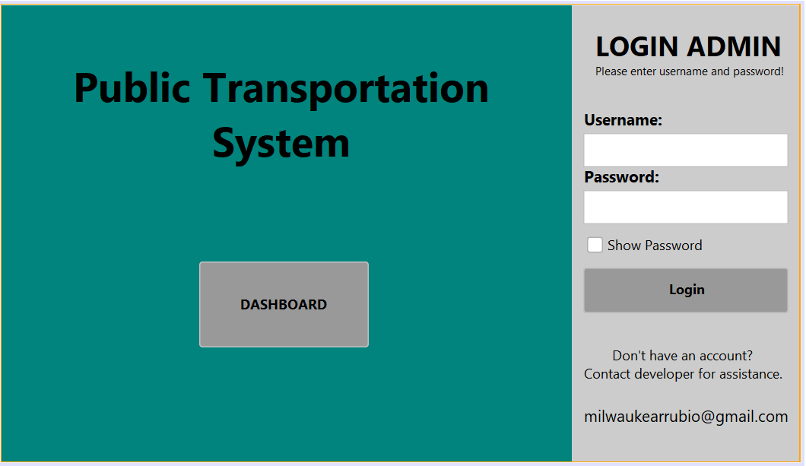
SYSTEM DESIGN
Main Interface:
Title "Public Transportation System" is prominently displayed in the center of the interface, giving the application its identity.
Dashboard Button:
A large button labeled "DASHBOARD" is placed below the title.
Clicking this button is likely intended to lead to a user interface.
Leads directly to a user interface or guest dashboard, skipping the login requirement for general information or non-restricted functionalities.

Slide 9
SYSTEM DESIGN
Admin Login Panel:
Located on the right-hand side.
Contains fields for:
Username: To input the admin's username.
Password: To input the admin's password.
A "Show Password" checkbox, which allows the user to toggle the visibility of the password.
A "Login" button for submitting credentials to authenticate the admin.
Assistance Section:
A message provides guidance for users who do not have an account or need assistance, with a placeholder email for contacting the developer (milwaukeearrubio@gmail.com).

Slide 10
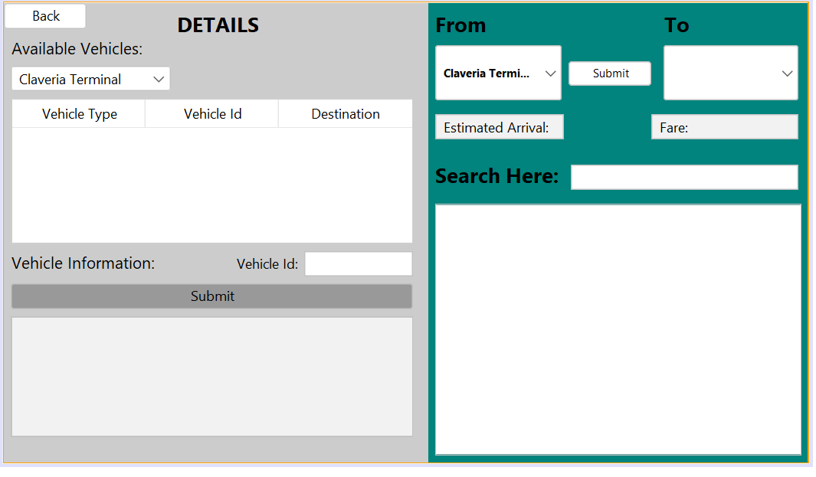
SYSTEM DESIGN
Back Button:
This button allows users to return to the main interface from any sub-page or detailed view within the application.
Choosing a Terminal:
The user selects a terminal from a combo box. This selection determines which set of available vehicles will be displayed.
Upon selecting a terminal, a table is populated with information about the available vehicles. This includes details such as vehicle type, vehicle ID, and destination.
Vehicle Information Section:
Here, the user can input a specific vehicle ID into a form. After submitting this ID, the system retrieves and displays detailed information about the vehicle, including the driver's name, contact details, and vehicle plate number.

Slide 11
SYSTEM DESIGN
Trip Planning Section:
On the right side of the interface, the user is presented with options labeled "From" and "To." These likely represent the origin and destination of a journey. After selecting both options and submitting the information, the system displays the estimated arrival time and date for the chosen trip.
Search Functionality
There is also a "Search Here where users can input search queries related to buses or other aspects of the service. The results of this search are then displayed in a table below, providing additional filtering or detailed information based on the user's query.

Slide 12
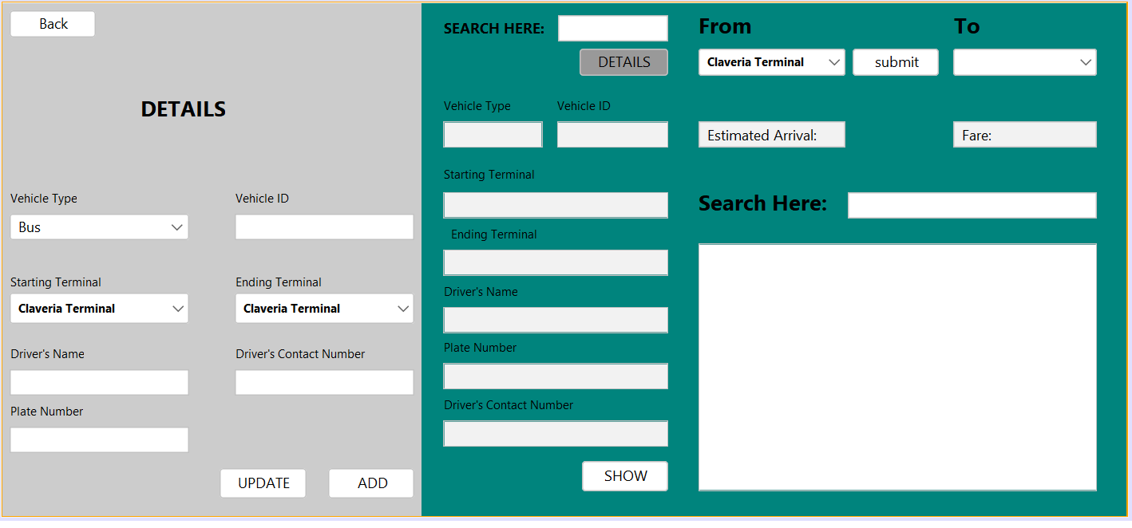
SYSTEM DESIGN
Details Section:
This is where the admin can add or update vehicle information.
Add Vehicle:
The admin selects "Add" and then chooses the vehicle type (bus or van).
The admin inputs the vehicle ID, starting terminal, ending terminal, driver's name, driver's contact number, and plate number.
After entering all necessary details, the user presses the "Add" button to save the new vehicle information.
Update Vehicle:
The admin can modify any of the existing vehicle details.
After making the necessary changes, the admin clicks the "Update" button to save the updated information.

Slide 13
SYSTEM DESIGN
Search Functionality:
On the right side of the interface, the admin can input search criteria in the "Search Here" field.
After entering the search criteria, the admin clicks the "Details" button.
The system retrieves and displays the relevant vehicle information in the text fields on the left side of the interface.
The "Show" button is automatically displayed in the details part on the left side if the user does not wish to input any more information.
Automatic Display:
When the admin searches for a vehicle, the corresponding details are automatically populated in the without requiring the user to input each detail manually.
This feature simplifies the process of viewing and managing vehicle information, making it efficient for admins to update and retrieve data as needed.

Slide 14
CONCLUSION
The Public Transportation System (PTS) addresses inefficiencies in terminal operations by providing real-time updates, enhancing passenger satisfaction, and improving operational efficiency. Key features include user-friendly trip planning tools, vehicle information displays, and an administrative interface, enabling passengers to access accurate trip details like estimated arrival times and fares while helping administrators manage and monitor the system effectively. This holistic approach ensures usability, transparency, and responsiveness, promoting broader public transportation adoption and improving overall user satisfaction.

Slide 15
RECOMMENDATION
To further enhance the functionality of the Public Transportation System (PTS) and expand its capabilities, the following recommendations are made:
1. Integration of Real-Time Vehicle Tracking.
2. Expansion to More Terminals.
3. Traffic Management Integration.
4. User Feedback Mechanism.
5. Extended Administrative Functions.
In conclusion, the Public Transportation System (PTS) lays a solid foundation for improving passenger experience and administrative efficiency. By adopting these recommendations, the system could evolve into a more comprehensive and adaptable tool that addresses the growing demands of modern public transportation networks.

